Slide 1
Essentials of Radiology: CXR Interpretation & Application
Allan Lovern, PhD(c), DNP, CRNA, FNP-BC, CNE
March 2023
University of Southern Mississippi

Slide 2
Outline
Basic terminology and concepts
Common conditions that CRNAs/SRNAs might encounter:
  pneumothorax
  pleural effusion
  atelectasis
  aspiration pneumonia
  foreign body obstruction
  mediastinal masses
View and discuss CXRs
Learning assessment and review

Slide 3
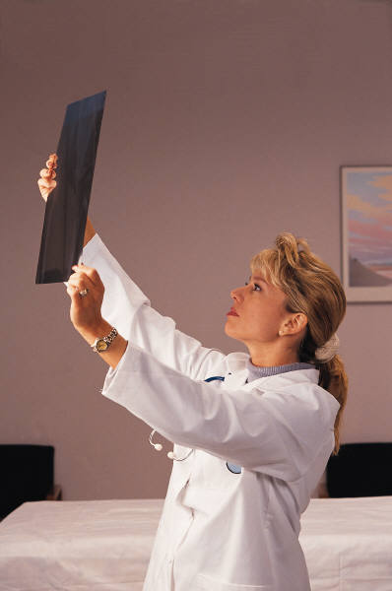
I can do this…

Slide 4
When do I request a CXR?
Value in obtaining routine CXRs is not impressive
Therefore, CXRs should not be routinely ordered
Decision: based on abnormalities identified during
the preop assessment (ie, rales, SOB
intercostal retractions, deviated trachea)

Slide 5
Miller text
CHEST RADIOGRAPH
Routine preoperative chest radiographs do not provide prognostically important information for assessing perioperative risk. Preoperative chest radiographs should therefore not be ordered routinely, but rather selectively based on abnormalities identified by preoperative evaluation. These indications include advanced COPD, bullous lung disease, suspected pulmonary edema, suspected pneumonia, suspected mediastinal masses, and suspicious findings on physical examination (e.g., rales, tracheal deviation).
Wijeysundera, D. N. & Finlayson, E. (2020). Preoperative evaluation. In M. T. V. Chan & K. Englehard (Eds.), Miller’s anesthesia (9th ed., pp. 918-998). Philadelphia, PA: Elsevier.

Slide 6
Justification for CXR
pneumonia (confirmation) immunosuppressed pt
COPD w/acute exacerbation foreign body
CHF aspiration pneumonia
blunt trauma lung tumor
chest pain suspected pneumothorax
SOB (severe) hemoptysis
pulmonary HTN Pulmonary embolus
interstitial lung ds ICU pt (adm, inv lines, ETT)

Slide 7
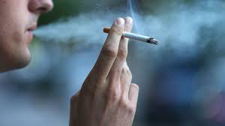
What about CXR in smokers?
Significant smoking history- 20 pack years

Slide 8
Will the results
change the
INTRAOPERATIVE
management of this patient?

Slide 9
Basic Tissue Densities
Black – air
Dark gray – subcutaneous tissue, fat
Light gray – soft tissue (muscles, heart, blood vessels, pus, etc)
Off white – bone
Bright white – metal (pacemakers, surgical clips, bullets, etc)

Slide 10
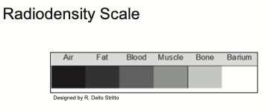
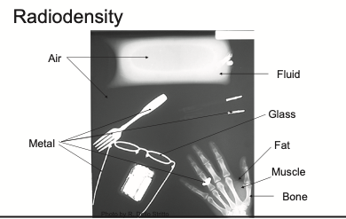
radiolucent vs radiodense (radiopaque)

Slide 11
Terminology
upright
supine
In addition, XRs are _____D, CTs are ____ D
PA (posteroanterior)*
AP (anteroposterior)
lateral*
male vs female

Slide 12
Male vs Female CXR
nipple shadows → men and women
compare both sides
overlying breast tissue → accentuates pulmonary vasculature
(careful, not to dx as infiltrate)
can tape BB or other metal object and reshoot film

Slide 13
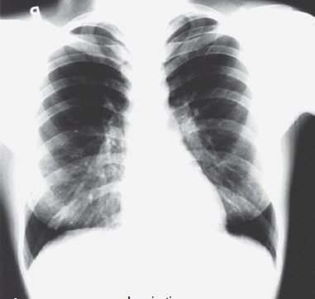
male vs female

Slide 14
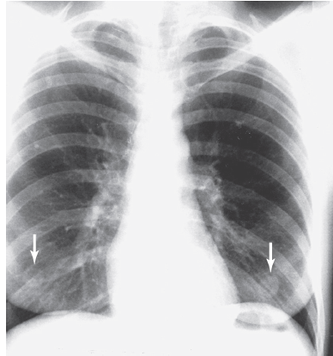
male vs female

Slide 15
supine or upright?

Slide 16
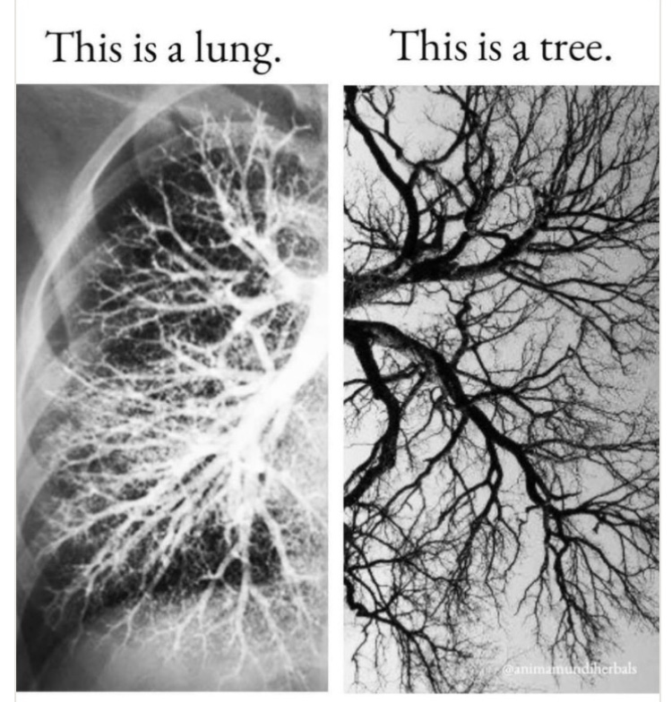

Slide 17
Supine
supine position limits full inspiration
cephalic push is noted- (liver and abdominal contents)
small pleural effusions will layer posterior (can easily be missed)
small pneumothoraxes will go anterior (can easily be missed)
Be careful interpreting supine films!

Slide 18
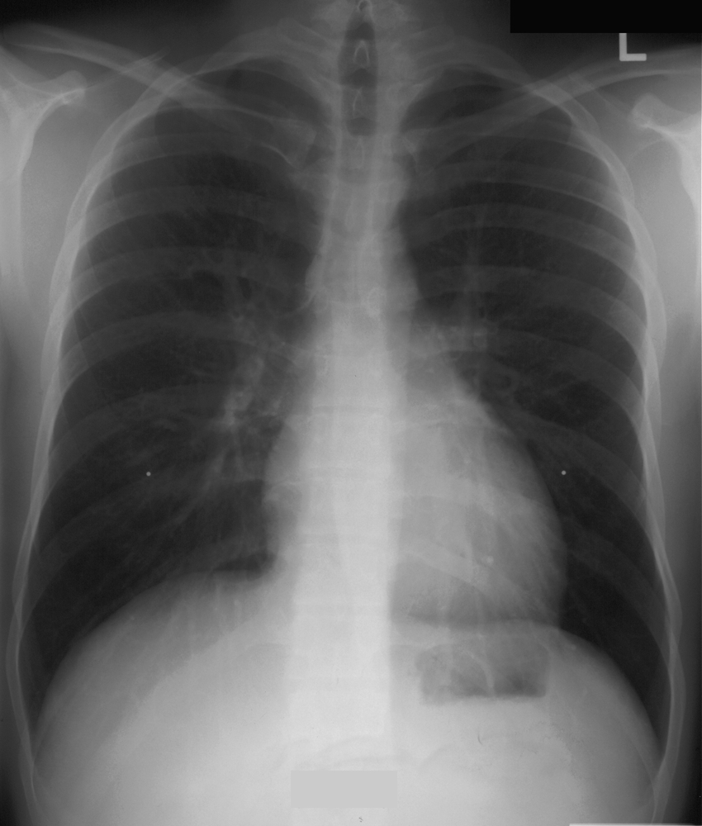
Upright
inspiration is greater
domes of hemidiaphragm at what level?

Slide 19
Inspiration and Expiration
Good inspiration = hemidiaphragm down to level of posterior 10th rib.
Hypoinflation = dome at 7th rib

Slide 20
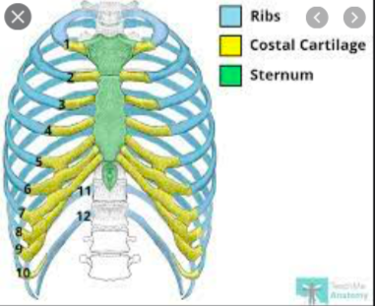
Counting Ribs

Slide 21
Question?
Why is the right
hemidiaphragm
higher than the
the left hemidiaphragm?
Notes:
The heart presses down on the left hemidiaphragm

Slide 22
CXR Projections
PA (posteroanterior)
AP (anteroposterior)
Can you explain the two terms?

Slide 23
Terminology
Why is terminology so important for the interpreter?
  upright
  supine
  PA
  AP
  lateral

Slide 24
Terminology
Position is TREMENDOUSLY important because the following might be affected:
  magnification
  organ position
  blood flow
  gravitational pull

Slide 25
AP vs PA
AP PA
X-ray beam is entering/exiting X-ray beam is entering/exiting
pt position pt position
detector plate position detector plate position
heart size heart size
diaphragm diaphragm

Slide 26
Considering what we know….
Before documenting that a patient has cardiomegaly, make sure that you are looking at which view? (PA)

Slide 27
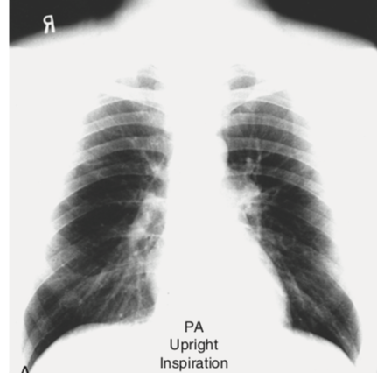
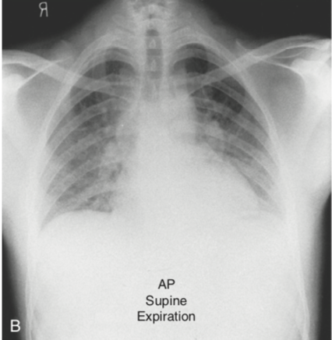

Slide 28
So,
Which view is most preferred?
Why?
So what about expiration?

Slide 29
Expiration usefulness
small pneumothorax: expiration will make the lung smaller and denser, and at the same time will relatively make the pneumothorax appear larger
lodged foreign body: “ball-valve phenomenon” – air can move past the object during inspiration, but during expiration (the bronchus gets smaller) and air can not exit around the obj. As a result, the expiration image will show air trapping in the affected lung and a mediastinal shift will occur.

Slide 30
Pneumothorax
Pneumothorax—air positioned between the visceral and parietal pleura
*trauma, subclavian venous catheter, liver biopsy (remember, the pleural space extends down quite far b/t the liver and lat. and post. abd wall)
*spontaneous (bleb rupture)
*metastatic tumors (osteogenic sarcomas)

Slide 31
Signs of a tension pneumothorax
lung compression
tracheal deviation
cardiac shifting
hemidiaphragm flattening or depression
If you diagnoses a tension pneumothorax clinically, do not request an CXR—TREAT THE PATIENT

Slide 32
costophrenic
angles (sulcus)=
formed by the lateral
chest wall & domes
of each diaphragm

Slide 33
Pneumothorax
supine or upright?
Where is the first place to look for pneumothorax?
deep sulcus sign: one of the most reliable signs → AP
action?

Slide 34
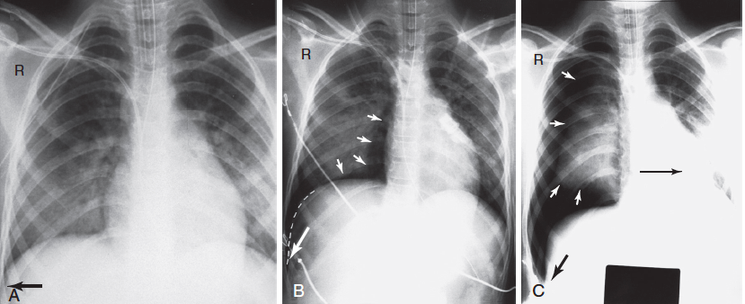
Deep Sulcus Sign

Slide 35
Pleural effusion
Pleural effusion—collection of fluid between the visceral and parietal pleura (~100 mLs to be detected on upright CXR)
Look for: blunting of costophrenic angles
increased basilar density (whiteness)
loss of normal lung-hemidiaphragm is noted
Causes: malignancies, pancreatitis (left-sided), cirrhosis (right-sided), CHF (bilateral), pneumonias
What is the preferred X-ray position? upright or supine

Slide 36
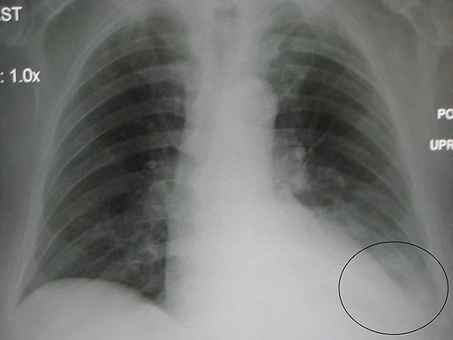
Costophrenic angle?

Slide 37
Decubitus view

Slide 38
Mediastinal shifts: push or pull
Tension pneumothorax: the mediastinum is shifted toward the unaffected side.
Atelectasis: collapse of entire lung segment might result in severe volume loss. The mediastinal is shifted toward the affected side
Tumor or mucous plug: affected side
Airway obstruction (ball-valve phenomenon): mediastinum is shifted toward the unaffected side
Pleural effusion: unaffected side
Notes:
Unaffected
Affected. Atelectasis- collapsed lung tissue due to resorption of air--> increased density (whiteness) and volume loss
Affected side due to volume loss p. 58
Unaffected p. 39
Let's add another, pleural effusion pushes the mediastinum to the unaffected side

Slide 39
Overexposure Underexposure

Slide 40
Exposure
Underexposure
Overexposure
Image is dark
Easy to see: Thoracic spine, clavicles, behind the heart, NG & ET tube placement
Cannot see: pulmonary vessels in the periphery, small nodules, or fine structures
Image is white
Easy to see: pulmonary vasculature (don’t mistake for infiltrate)
Cannot see: behind the heart, spinal anatomy, or behind hemidiaphragms

Slide 41
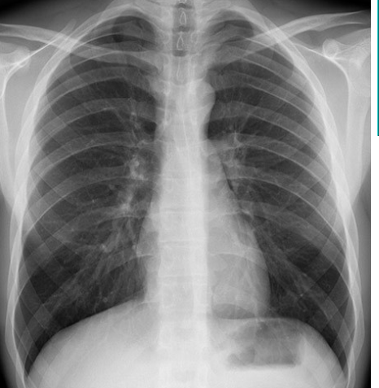
Correct exposure
vessels to at least the peripheral 1/3rd of the lung
visualization of paraspinous margins
visualization of the hemidiaphragm behind the heart

Slide 42
Know
the
major
landmarks

Slide 43
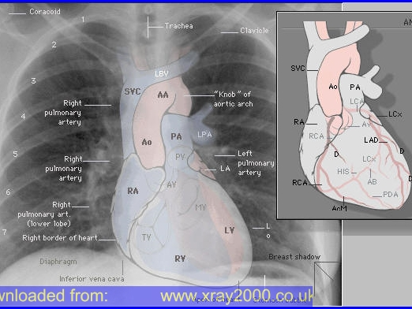

Slide 44
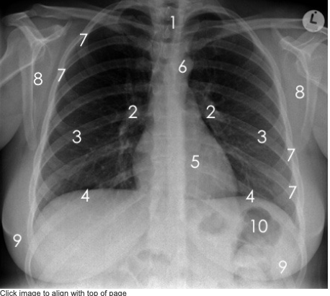
How many structures can you name?

Slide 45
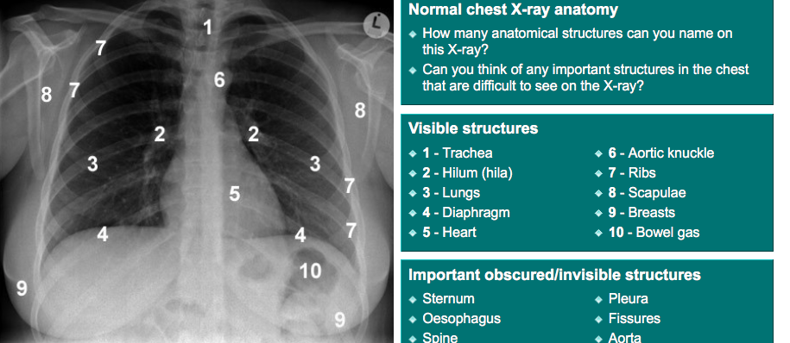

Slide 46
The heart is the easiest structure to see!
How big is too big?

Slide 49
Aspiration pneumonia
Aspiration: the inhalation of gastric contents
*following seizure, cardiac resuscitation, anesthesia-related complication
CXR usually performed immediately after incidence
F/U should be performed within 12 hours (it may take several hours for the gastric contents to react with the lung to cause fluid exudate and an alveolar infiltrate)

Slide 50
Mediastinal masses
Mediastinal mass → widening or bulge in the central soft tissue of the chest
Anterior Middle Posterior (lateral view)
thymoma t. aortic aneurysms neurogenic (90%)
thyroid lesions neoplasms neuroblastomas teratoma adenopathy schwannomas T cell lymphoma diaphragmatic hernias ganglioneuromas
The 4 Ts

Slide 51
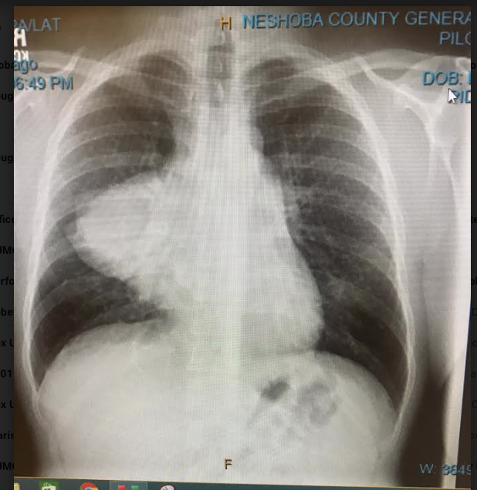
28 y/o healthy male –c/o difficulty breathing

Slide 52
Systematic approach
Who (correct patient)
What (film orientation) → AP, PA, supine, upright
When (date)
Why (reason for X-ray) → history and PE are extremely important
Exposure?

Slide 53
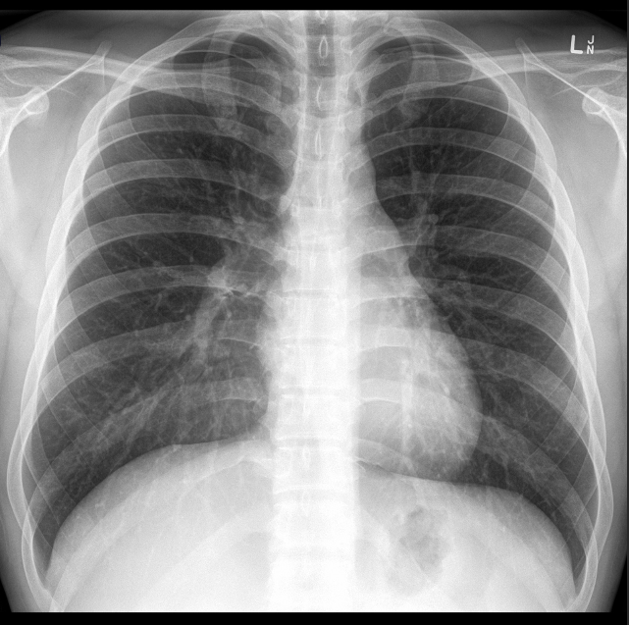
Systematic approach
Airway
Bones
Cardiac
Diaphragm/mediastinum
Everything else

Slide 54
GREAT RESOURCE!
https://www.radiologymasterclass.co.uk

